Slide 1
Let’s Create a Resort Flyer
Missouri Resorts

Slide 2
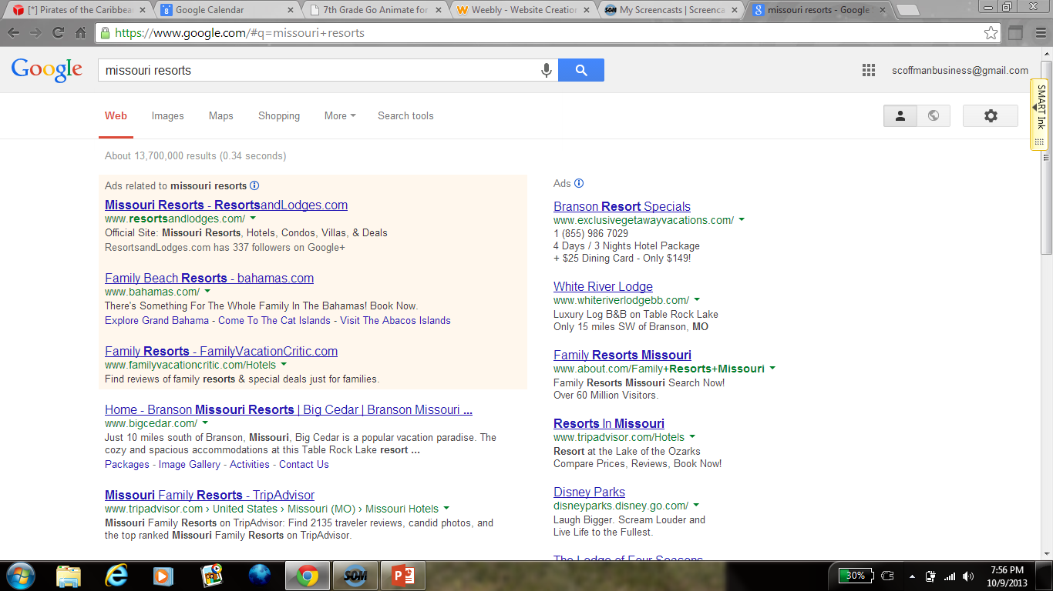
To Start
Go to google
You will research “Missouri resorts”
You will find one that you like to research Example:

Slide 3
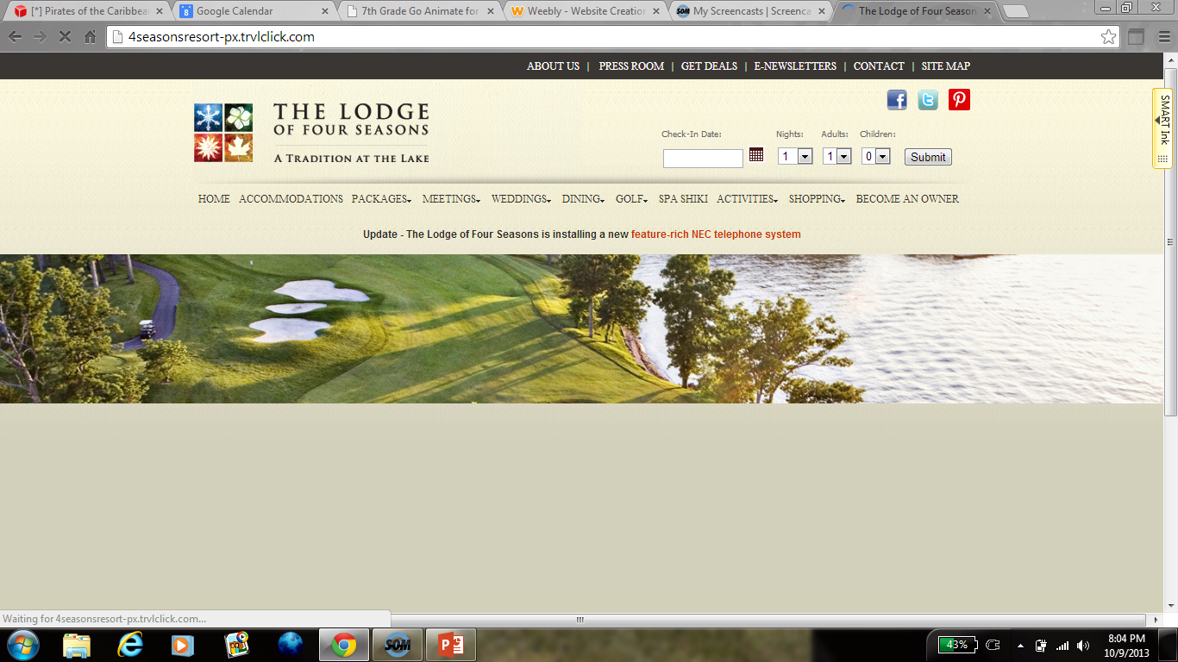
I found my resort
Okay now you have found your resort…so now what do you do????
I have chosen Lodge of the Four Seasons

Slide 4
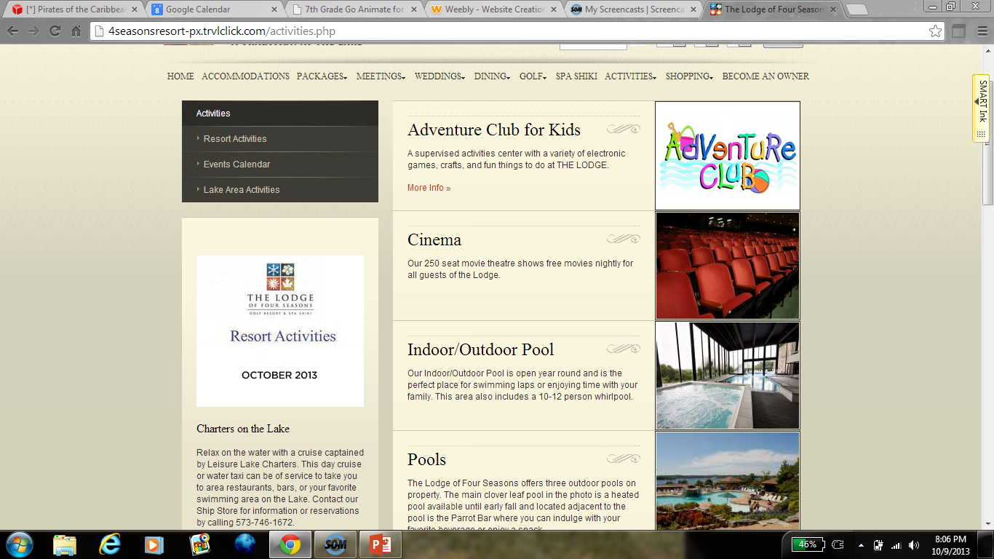
Look at the Amenities
You need 6 things that you can do there. Look under activities or things to do

Slide 5
Information
You need the address, phone number and website

Slide 6
Creating a QR Code
You are going to create a QR code for the website. Go to the generator and choose URL on the left hand side. You will type the website of the resort and create the QR Code. You will save this image for your flyer.

Slide 7
QR Code Generator
http://www.the-qrcode-generator.com/

Slide 8
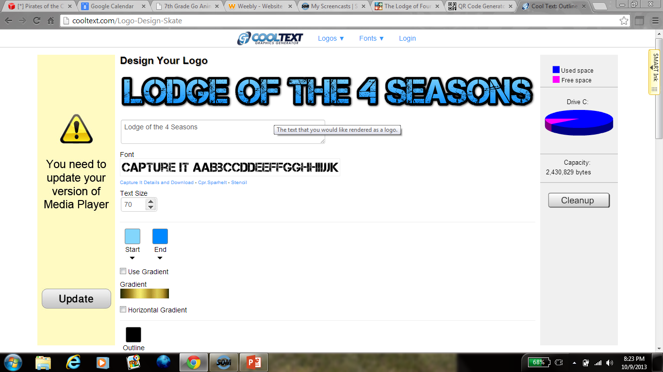
Using font generators
You will go to a font generator of your choice. Generators would be cooltext.com, flamingtext.com, sparklee.com, glitteryourway.com.
You will create your resort name

Slide 9
Next your subtitle
Your subtitle can be activities or things to do
Remember this is your 2nd font and you want to look nice with your heading. You want to keep a good color scheme
In your 3rd font you will list your activities with a little about them. Use your bullets for the list

Slide 10
Now setup your page like example
We are not done Yet!!!!

Slide 11
The fun part
Now you have to create your artwork with draw tools. For example I am making the following –be CREATIVE

Slide 12
Other things
You can change the background
Look at grammar and spelling
Let me over look so that you have all parts.

